Slide 1

Mathematical optimization
Booz Allen Hamilton INC. internal
Optimizing decision-making for Veteran’s Affairs
Feb 2023

Slide 2
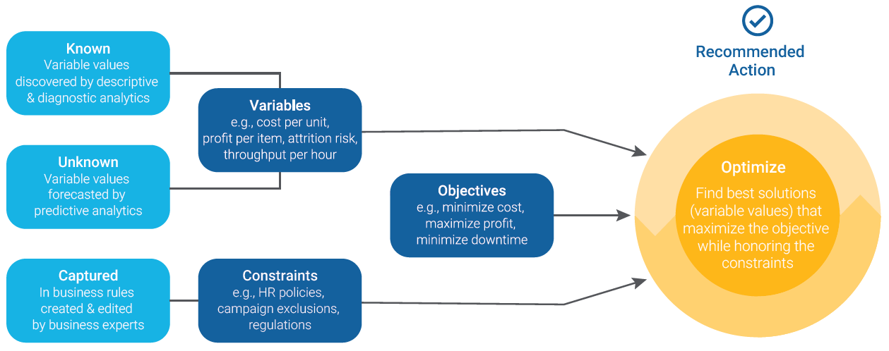
Use of Mathematical optimization
Definition: Mathematical Optimization is the process of funding the best solution to a problem, given a set of constraints and objectives.
Process
Define the variables: Identify the factors that are relevant to the problem, such as quantities, distances, or time. These are the variables that you will try to optimize.
Set constraints: Establish any constraints or limitations that may affect the solution. These could be anything from budget constraints to time constraints, physical limitations, or legal requirements.
Define the objective function: Create an objective function that expresses the relationship between the variables and the goal you want to achieve. This function represents the objective that you want to optimize.
Apply optimization algorithms: Use mathematical algorithms to find the optimal solution. These algorithms vary depending on the type of problem and the constraints involved.
Interpret and implement the results: Once you have found the optimal solution, interpret the results and implement them in the real world. This could involve making changes to a manufacturing process, adjusting prices, or making other strategic decisions.
Image source: https://community.fico.com/s/what-is-mathematical-optimization
Notes:
How does their current approach even work?

Slide 3
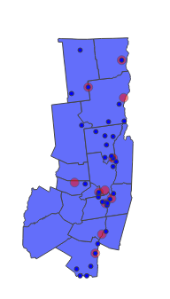

VISN 02 eastern market optimization
Goal:
Determine optimal decision around whether the VA should partner with existing community-based outpatient facilities or just upgrade the existing Albany VAMC, based on expected veteran enrollee projections and other data.
Data:
Use data from a "Data Discovery & Findings" slide deck to consider all existing facilities in the region, as well as the expected veteran enrollee projections in 2027 from each county in the area.
In addition, generate hypothetical data around costs, patient satisfaction with facilities.
Constraints:
The decision is based on three key constraints: the maximum distance between any zip code and a facility (existing or new), the minimum level of satisfaction patients feel with facilities, and the total budget allocated for this partnership/upgrade effort.
Decision variable:
The decision variable is which additional community-based facilities the VA should partner with in the region (if any) and whether the VA should upgrade the facility at Albany.
Optimization objective:
Maximize the coverage of veterans living within a specified distance of any facility, while minimizing the total costs involved.

Slide 4
Data description
Existing facility zip codes
VA DDF Slide deck
Potential partner facility zip codes
NYS Health center data
Distance between all pairs of zip codes
Projected veteran enrollee count from each zip code
Projected enrollee counts from each county obtained from VA DDF Slide deck
County counts extrapolated to zip population based on census veteran proportions.
Cost of establishing a new partner facility –
Hypothetical data ranging from $375K to $2M
Cost of upgrading Albany facility –
Hypothetical $10M
Patient satisfaction with all existing and potential partner facilities –
Hypothetical ranging from 1.0 to 4.5 out of a 5.0 scale.

Slide 5

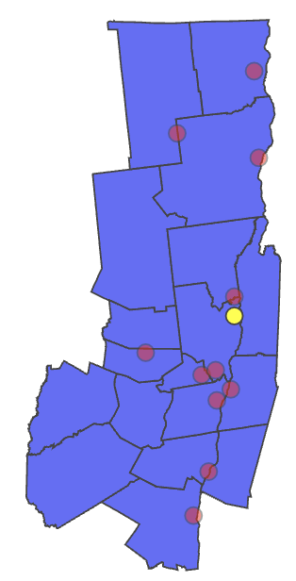
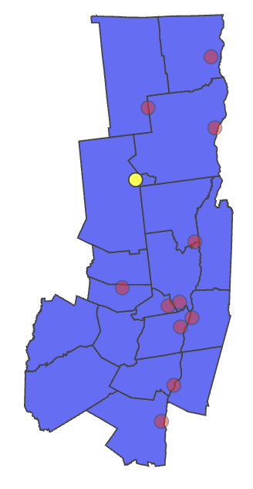
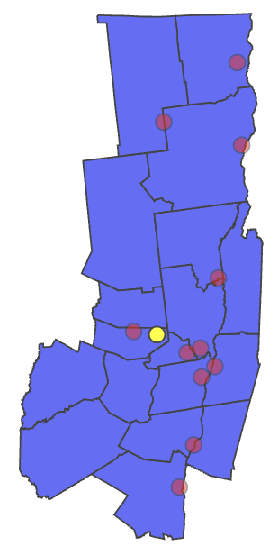
Experiments and results [max coverage and min cost]
Allowable drive distance: 20 mi
Allowable drive distance: 10 mi
Allowable drive distance: 20 mi
Max Budget: $390K
Total Cost | $400,000
Total Coverage | 90.8%
Total Cost | $375,000
Total Coverage | 71.6%
Total Cost | $385K
Total Coverage | 83.2%

Slide 6
Extensions and opportunities
Sensitivity analysis
Technique used to determine how changes in input variables and data affects the output of the model.
Help inform whether to update or refine the input data, and to identify key variables and parameters that the model output is most sensitive to.
Multi-objective optimization
Naive multi-objective optimization that relies on a weighted sum of competing objectives can be inefficient, as it assumes all objectives are easily comparable.
Real-world problems often involve multiple objectives that are not easily comparable, and where the relative importance of each objective may vary depending on the specific context and stakeholders involved.
More advanced multi-objective algorithms, such as evolutionary algorithms or multi-criteria decision-making methods, can help to identify the Pareto-optimal solutions and explore the trade-offs between competing objectives, leading to more nuanced and insightful solutions that are better aligned with the needs of all stakeholders.

Slide 7
Additional data
Utilization rates for facilities
Data on how frequently veterans are using existing facilities can inform decisions about whether to partner with additional facilities or upgrade the existing ones.
Demographic data
We could incorporate demographic data such as age, gender, race/ethnicity to better understand the needs to veterans in the area in a personalized manner.
Medical needs
Breaking patients up by primary care, mental health, surgical care, and telehealth needs could inform decisions about which types of facilities to partner with or upgrade.
Patient acuity
Data on patient acuity (how sick patients are) could be tied to utilization rates for various types of services being provided.

Slide 8
Mathematical optimization in practice (example use cases)
Eurodecision Geneva Airport Shift and Personnel Planning Optimization
Objective: Optimize staff shift scheduling and personnel resource planning at Geneva Airport while reducing costs.
Decision variable: Shift schedules and number of personnel for different types of staff.
Constraints: Legal and regulatory requirements, service level agreements with airlines, and staff availability.
Copenhagen Airport Gate and Stand Assignment
Objective: Assign gates and stands at Copenhagen Airport to reduce delay and improve efficiency.
Decision variable: Assignment of gates and stands for flights.
Constraints: Capacity of gates and stands, flight schedule, and airline preferences.
ICRON Supply Chain Optimization
Objective: Optimize supply chain planning for a manufacturing company to reduce costs and increase efficiency.
Decision variable: Production planning, inventory levels, and transportation scheduling.
Constraints: Production capacity, inventory levels, transportation costs, and delivery deadlines.

